Slide 1
MULESOFT QUIZ QUESTIONS

Slide 2
Quiz Rules
The quizzes consists of questions carefully designed to help you self-assess your comprehension of the information presented on the topics covered in the module.
Each question in the quiz is of multiple-choice format
The quiz will consist of 3 questions.
Each question will generally have four options, and participants must choose the correct answer.
You can only submit your answers once.
Participants will earn points for each correct answer, and the winner will be chosen at the final session.
The top 3 participants will be chosen based on the number of right questions answered, and then we will randomly choose one lucky winner from the top 3.
We will be maintaining all the participants ranks with us.
For each question, there will be only one participant who gives the fastest right answer, and they are not allowed to give multiple answers to the same question.

Slide 3
Day 2

Slide 4
1. What MuleSoft product enables publishing, sharing, and searching of APIs?
API designer
Runtime manager
Anypoint exchange
API notebook
Answer: C

Slide 5
2. A RAML example fragment named BankAccountsExample.raml is placed in the examples folder in an API specification project. What is the correct syntax to reference the fragment?
examples: !include examples/BankAccountsExample.raml
examples: #import BankAccountsExample.raml
examples: !include BankAccountsExample.raml
examples: #import examples/BankAccountsExample.raml
Answer: A

Slide 6
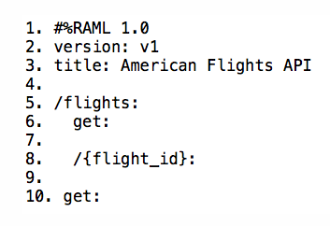
3. Refer to the exhibit. There is an error in the flight_id resource's GET method. What needs to be done to fix it?
Remove blank line on row 9
Remove the curly braces {} around flight_id
Indent the get method under the {flight_id} resource
Outdent the {flight_id} resource
Answer: C

